Slide 1
Clinical Data Handling and Automation Challenge
Novo Nordisk

Slide 2
Louisa Rebello
LMZR@novonordisk.com
Mentor
TEAM
2
Ayush Rahangdale
ayushrahangdale1610@gmail.com
Prathamesh Parab
prath.parab11@gmail.com
Prasad Toley
prasadtoley@gmail.com
M.Sc. Bioinformatics
Dr. D.Y. Patil College of Art, Commerce & Science, Pimpri, Pune

Slide 3


Data Visualization and Automation [Track 2]
Why we choose this Track?
As we had previous experience with Data Visualization, performing Covid-19 with Python Libraries, so it makes more interesting for us to work and explore the different analytics
Data visualization enables us to recognize emerging trends and respond rapidly with spotting patterns and speed up the decision-making process
Data visualization is a vast field with immense growth options and will have a greater impact in future of data analytics

Slide 4
Our Data
What data we are working on? And what it speak about?
Informed consent & Visits
Concomitant medications
Subjects
Adverse Events
An individual who participates in a clinical trial either as a recipient -------
Observation of their gender, age, city/region
process ensures the individual's autonomy, to voluntarily participate in a trial
-------
specifies the date on which the visit was performed
An unfavorable change in the health of a participant during the clinical trial
------
Seriousness, Severity code, Date of Onset , admission, discharge
are other prescription medications, over-the-counter (OTC) drugs or dietary supplements that a subjects takes in addition

Slide 5

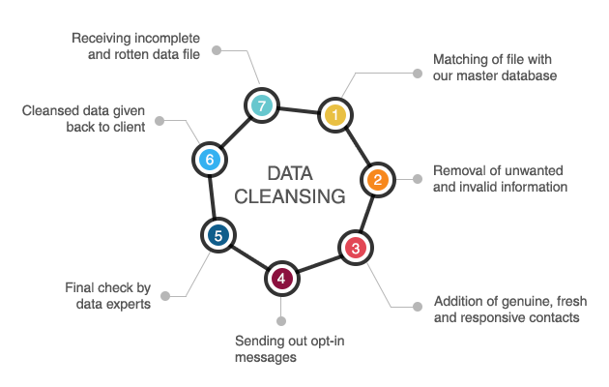
Data Visualization and Data cleaning
Why we choose this Data?
To explore and learn Clinical trial aspects
Data visualization has the potential to reduce bias in the reporting of harms and to present a more holistic picture of harms, compared with current methods
Data cleaning is the process of fixing or removing incorrect, corrupted, incorrectly formatted, duplicate, or incomplete data within a dataset

Slide 6
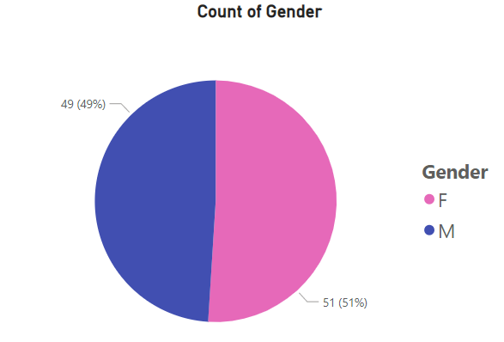
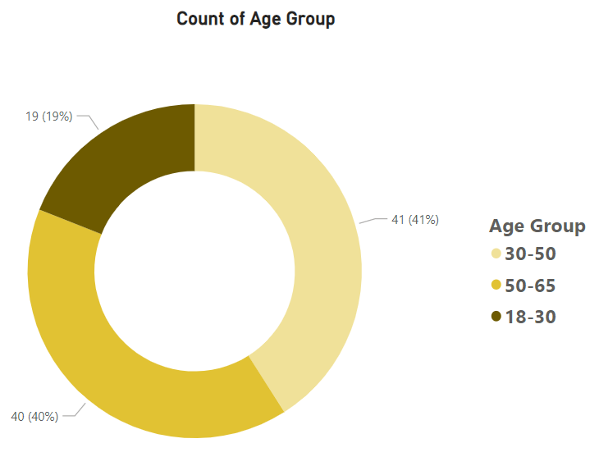
Introduction to Data
Visual Insights
Demographic Charts
Subjects
100
Phase 2 clinical trial Study
randomized, controlled studies evaluating the safety and efficacy of a drug for a particular condition

Slide 7
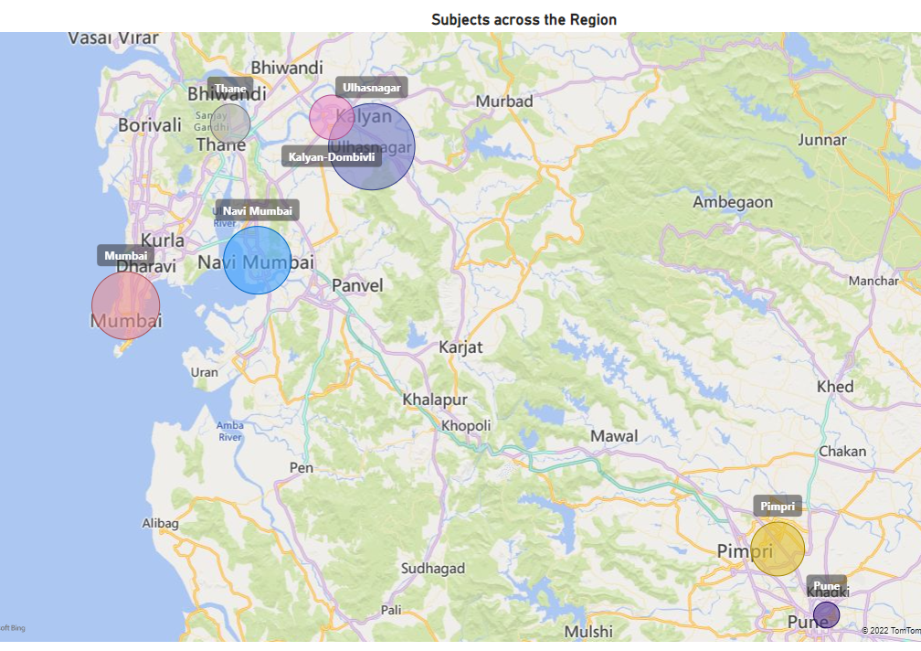
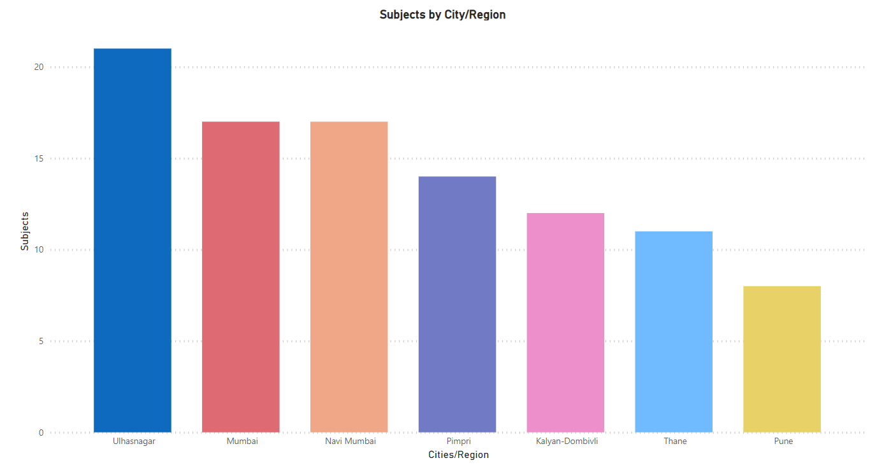
Introduction to Data
Visual Insights
Map Charts
Distance field is used to find studies with locations within the specified distance from a city in number of miles/km(100 miles preferred)

Slide 8
Introduction to Data
Visual Insights
Gender
Selection Layout
A Selection canvas is a key tool for any data visualization project
It lays out the branding strategy for your visualization and helps to keep all aspects of the design cohesive
Reporting only frequencies ignores other dimensions of the data that are important including severity, seriousness, rate (recurrence), timing, and groups of related harms
City/Region
Seriousness
Canvas Selection
Severity
Outcome

Slide 9
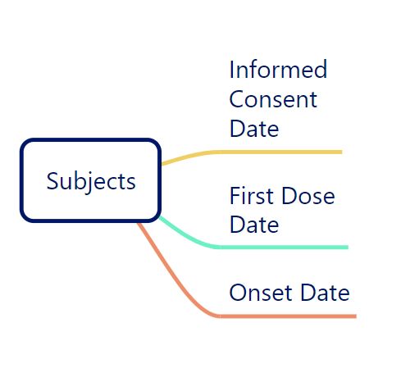
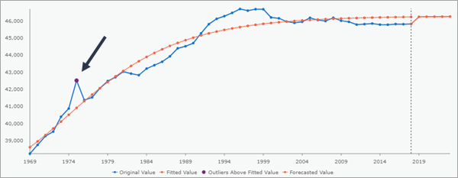
Summary | Visualization | Analysis
Visual Insights
11 Nov 2016
11 Nov 2016
Outliers
Overlapping Dual Line graphs shows the Outliers
Majorly used for Timeline graphs
02 May 2019
16 Feb 2016
17 Aug 2019
17 Aug 2019
Expected
Outliers

Slide 10

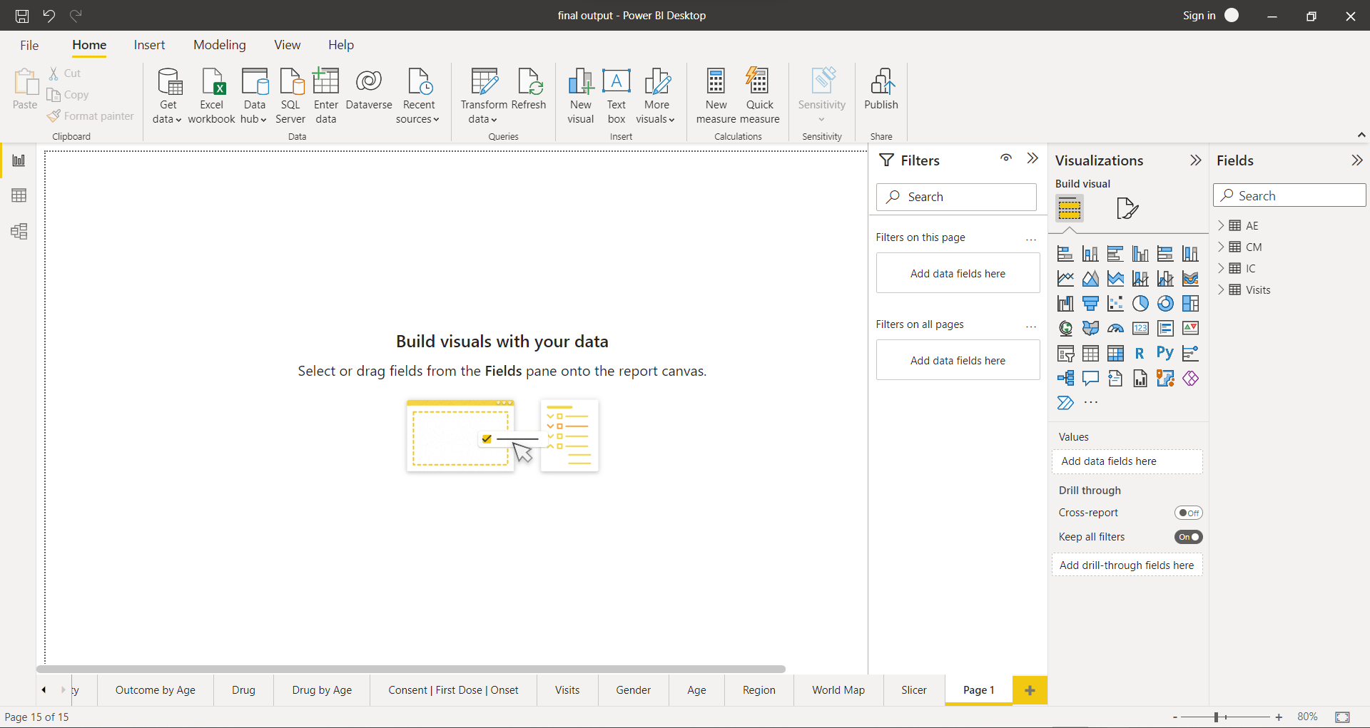
Power BI Desktop
Why we choose to work on this Tool?
Power BI Desktop is freely available
Consolidate multiple data source (Excel, CSV, XML, Text, …)
Interactive reports and geo-map visualizations
Integration of R, Phyton and SQL
Consistent reporting and analyses
View reports across multiple platforms and devices
In constant evolution
Other tools we used is Tableau Public
Power BI Desktop Tool

Slide 11
Thank you
Thank you for giving us the opportunity and the learning experience

